Slide 1
Topics (Part 1)
Basic concept of management
Definition
Importance of management
Characteristics of management
Levels of management
Management skills
Scientific management
Contribution of Gilbreth-Gantt

Slide 2
Basic Concept of Management..??
Management is the process of creating an atmosphere, wherein individuals working together in groups, accomplish a given objective with the highest degree of productivity.

Slide 3
Definition
Management is an art of getting the work done through the efforts of people and by the effective utilisation of resources.
Management is the process of creating an atmosphere, wherein individuals working together in groups, accomplish a given objective with the highest degree of productivity.
For getting the work done, it is necessary to guide, direct, coordinate and control human efforts for the fulfillment of the goals of the enterprise.
Management does not frame policies, it only implements/executes the policies laid down by the administration.

Slide 4
Management is a set of principles relating to the functions of planning, organizing, directing and controlling, and the application of these principles in harnessing physical, financial, human, and informational resources efficiently and effectively to achieve organizational goals.

Slide 5
Importance of management
Increasing the effectiveness and efficiency
Development of full human potential
Raising the worker morale
Building mutual trust
Developing teamwork
Providing a stable livelihood for all employees
Constantly and forever improving the system of production and service.

Slide 6
Characteristics of Management
Management is a purposeful activity: Objectives differ from organisation to organisation
Efficient management of economic resources
Management is a distinct process
Management is universal: applicable to all group of activities
Management applies to managers at all organizational levels
The aim of all managers is the same: to be productive.

Slide 7
Characteristics of Management
Co-ordination is the soul of management
Management is dynamic
Management attempts to create a desirable future, keeping the past and present in mind.
Management is decision making
Management is a profession

Slide 8
Levels of Management
The 3 levels of management that are commonly found in an organisation are:
Top management
Middle management
Lowest or supervisory management
Board of Directors, MD, CEO, GM
Departmental heads, Superintendents
Foreman, supervisors etc
Top
Level
Middle Level
Lowest Level

Slide 9
Top level Management
Top level management is responsible for framing policies of the organization.
All critical decisions are also made at this level.
Top level management consists of board of directors, managing director, general manager and senior most managers.
Top level management is administrative in nature.

Slide 10
Top level Management
Functions
Develops long - range plans and strategies
Top management lays down the objectives and broad policies of the enterprise.
Issues necessary instructions for preparation of department budgets
Consults subordinate managers on subjects or problems of general scope
Involved in selection of key personnel
Controls and coordinates the activities of all the departments

Slide 11
Middle level Management
Middle level management is the link between top level and low level management.
They devote more time to organizational and directional functions.
These managers supervise, direct and control the activities of foremen, inspectors and supervisors.

Slide 12
Middle level Management
Functions
Makes plan of intermediate range and prepares long - range plans for review by top level management
Establishes departmental policies
Counsels subordinates on production, personal or other problems
Selection and recruitment of personnel
Training of lower level management
Interpret and explain policies from top level management to lower level
Coordinating activities within the division or department
Sends important reports and other relevant data to top level management
Evaluate performance of junior managers
Motivate lower level managers towards better performance

Slide 13
Lower level Management
Lower level is also known as supervisory / operative level of management. It consists of foremen, inspectors, supervisors etc.
They will be mainly concerned with direction of operative employees.

Slide 14
Lower level Management
Functions
Makes detailed, short - range operating plans
Assigning of jobs and tasks to various workers
Supervise and guide the sub-ordinates
Reviews performance of subordinates
Supervises day - to - day operations
Responsible for the quality as well as quantity of production

Slide 15
Lower level Management
Functions
Communicate workers problems, suggestions, and recommendatory appeals etc. to the higher level and higher level goals and objectives to the workers
Solve the grievances of the workers.
Training of workers
Arrange necessary materials, machines, tools etc. for day - to – day operations
Prepare periodical reports about the performance of the workers
Ensure discipline in the enterprise
Motivate workers

Slide 16
Managerial Skills/ Management Skills
It’s the ability of a manager to make a smooth functioning team of people working under him.
It involves obligation to make effective utilization of human and material resources.

Slide 17
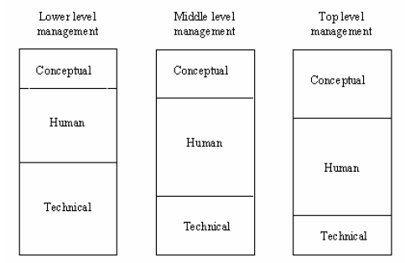
Managerial Skills
Types
Technical skills
Conceptual skills
Human relational skills

Slide 18
Technical skills
Technical skill is the ability to perform a manger’s job.
An accountant, doctor, engineer or a musician all have technical skills in their respective fields of specialization.
A manager must possess technical skill.
It refers to the proficiency in handling methods & techniques to perform particular tasks.

Slide 19
Conceptual skills
It is the ability to coordinate and integrate the entire organizational interests and activities.
a) Decision making skill: ability to make accurate and right decisions at the right time.
b) Organizational skill: ability to recruit and allocate right person for the right job.
A manager must have the ability to see the organization as a whole and not make decisions from his own departmental point of view.
He must be able to see how his department is affected by the decisions of others.

Slide 20
Human relational skills
It is the ability to build cooperative workgroups to achieve organizational goals.
a) Communication skills: ability to pass on information to others.
b) Motivating skills: ability to encourage the subordinates.
c) Leadership skills: ability to inspire confidence and trust in subordinates in order to have maximum cooperation from them for getting work done.
The manager must focus his attention on improving his interpersonal relations with peers, subordinates, and his own supervisors.

Slide 21
Scientific management
“Art of knowing exactly what is to be done and the best way of doing it”.
Scientific management is a theory of management that analyzes and synthesizes workflows, with the objective of improving labor productivity.
It’s the result of applying scientific knowledge and the scientific methods to the various aspects of management and the problems that arise from them.
Helps to improve productivity and standardize human efforts.

Slide 22
Contributions of F.W. Taylor (1856 – 1915)
The core ideas of the theory were developed by Frederick Winslow Taylor (1856 – 1915) in the 1880s and 1890s.
Known as father of scientific management.
Scientific management's application is contingent on a high level of managerial control over employee work practices.
“A complete mental revolution” on the part of management and labour.
Stressed the importance of “time and motion study” to increase efficiency of men and machines.
Introduced a wage incentive plan known as differential rate system, which involves payment of higher wages to more efficient workers.

Slide 23
Four basic principles of F.W. Taylor
Develop a science for each element of a man’s work, which replaces the old rule of thumb method.
Scientifically select and then train, teach, and develop the work man, where as in the past he chose his own work and trained himself as best as he could.
Heartily cooperate with the men so as to ensure all of the work being done is in accordance with the principles of science, which has been developed.
There is an almost equal division of the work and responsibility between management and workmen. The management takes over all work for which they are better fitted than the workmen, while in the past almost all of the work and the greater part of the responsibility were thrown upon the men.

Slide 24
Principles of Scientific Management (F.W. Taylor)
Development of science for each element of work:- analyze the work scientifically (what, when, who, how.??)
Scientific selection, placement and training of workers.
Division of Labour
Standardization of methods, procedures, tools and equipment.
Use of Time and motion study.
Differential wage system:- Doesn’t guarantee a min: wage
Co-operation between Labour and management.
Principle of management by Exception:- Only significant deviations b/w actual performance and standard performance should be reported to top managers.

Slide 25
Contributions of Henry L Gantt (1861-1919)
Improved Taylor’s differential piece rate system and came up with a new idea - every worker who finished a day’s assigned workload would win a 50% bonus.
The supervisor would also earn a bonus for each worker who reached the daily standard, plus an extra bonus if all the workers reached it. This would motivate the supervisors to train their workers to do a better job.
Devised a charting system for production scheduling, now known as Gantt chart. The Gantt chart is still in use today – basis of the Critical path Method (CPM) and Program Evaluation and Review Technique (PERT).

Slide 26
Contributions of Frank B and Lillian M Gilbreth (1868-1924 and 1878-1972)
Did a lot of research in order to improve work methods and thus to discover one best way of accomplishing a task.
Main field of interest was fatigue and motion studies and focused on ways of promoting the individual worker’s welfare.
The ultimate aim of scientific management was to help workers reach their full potential as human beings.
Motion and fatigue were intertwined – every motion that was eliminated reduced fatigue.
Using motion picture cameras, they tried to find the most economical ways of doing jobs. They concluded that fatigue could be considerably reduced by lightening the load, spacing the work and by introducing rest periods.

Slide 27
Dr. Lillian Gilbreth
Known as the first lady of management.
Lillian's thesis turned - book, The Psychology of Management, is one of the earliest contributions to understanding the human side of management.
Her work illustrated concern for the worker and attempted to show how scientific management would benefit the individual worker, as well as the organization.
Lillian wrote about reduction of worker fatigue, how to retool for disabled veteran workers returning to the workplace, and how to apply principles of scientific management to the home.

Slide 28
Topics (Part 2)
Functions of management
Planning
Forecasting
Organizing
Staffing
Directing
Motivating
Controlling
Coordinating
Communicating
Decision making

Slide 29
1. Planning
It is the most important and prerequisite of all the other functions.
It is the process of establishing goals and suitable course of action to achieve that goals.
It consists of goals, policies, procedures, rules, strategies etc.
Plans made by top-level management may cover periods as long as five or ten years. On the other hand, the middle and lower level managers focus on short-range and day-to-day plans.
It is done in accordance with past events and forecasting events in the future.
The elements included in the planning function are:
The policies that will help to achieve objectives.
The programmes that a manager will carry out
The time schedules that a manager will have to meet
The budgetary considerations that will be involved

Slide 30
2. Forecasting
It is defined as an estimate of future events, by systematically combining past and present data.
It forms the basis of planning of activities of an organization.
The survival of any manufacturing enterprise depends on its ability to assess, with reasonable accuracy, the market trends several years ahead.
Forecasting begins with sales forecast and is followed by production forecast and forecast for costs, finance, purchase, profit etc.

Slide 31
Organizing
Organizing is the process of arranging and allocating work, authority, and resources among an organization’s members so that they can achieve organization’s goals.
The process of organizing involves:
Identifying the works to be performed
Classify the work or group the work
Assigning activities to the groups or work to individuals
Fixing responsibilities
Deciding the hierarchy of authority

Slide 32
Staffing
The main purpose of staffing is to put right man on right job.
It involves manning the positions created by organization process.
It is a process of filling or keeping filled the various positions in the organizational structure.
It involves:
Manpower Planning (estimating man power in terms of searching, choose the person and giving the right place)
Recruitment, selection & placement
Training & development.
Remuneration
Performance appraisal
Promotions & transfer

Slide 33
5. Directing
Directing is said to be a process in which the managers instruct, guide and oversee the performance of the workers to achieve predetermined goals.
Directing is said to be the heart of management process. Planning, organizing, staffing has got no importance if direction does not take place.
Directing initiates action and it is from here actual work starts. Therefore, Directing is guiding, inspiring, overseeing and instructing people towards accomplishment of organizational goals.
It includes:
Issuing orders that are clear, complete and within the capabilities of subordinates to accomplish.
Suggesting an incessant training activity in which subordinates are given instructions to enable them to carry out the particular assignment in the existing situation.
Motivating the workers to meet the expectations of the manager
Maintaining discipline and rewarding those who perform well

Slide 34
Motivating
It means inspiring people to intensify their desire and willingness to perform their duties effectively and co-operate for the achievement of common objectives of the business.
Motivation is a human psychological characteristic.
It pertains to various drives, desires, needs, wishes and other forces.
Motivation is not easy to achieve and what a manager can try to do is to create a working climate in which all members may contribute to the limits of their ability.
Motivational function provides a great deal of challenge to a manager. He must have the ability to identify the needs of his subordinates and the methods and techniques to satisfy those needs.

Slide 35
Motivating
The key elements in such a work situation and its effect on the employee are known to be:
The degree to which the employee feels his goals and those of the organization are similar.
The employee’s relationships with his coworkers and especially with his supervisor.
The way in which his job helps him meet his needs for present income and future security and does so in a manner that seems fair.
The extend to which it enables him to feel adequate to his tasks and to gain a sense of accomplishment for jobs well done.

Slide 36
7. Controlling
Controlling is the process of ensuring that actual activities conform to plan activities. It measures the progress of operations and making sure that things are proceeding in the right direction as planned
For the control to be effective, a system of communications or reports is required to inform the manager of the facts on which to base measurements, comparisons and corrective action.
A great deal of the manager’s time is involved in controlling
It involves:
Establishing standards of performance.
Measuring actual performance.
Comparing actual performance to the established standards.
Taking corrective action if deviations are detected.

Slide 37
8. Coordinating
Coordination is the process of integration of the activities of separate departments of an organization to accomplish organizational goals.
It involves harmonizing the individual goals of the subordinates with the goals of the organization.
Coordination is needed both up and down the organization structure and laterally as well.
It can also occur among people working at different organizations.
The extent of coordination depends on the nature of activities performed and the type of organization structure.

Slide 38
9. Communicating
It’s a process by which instructions, ideas, thoughts or information are transmitted, received and understand by persons working in organization.
Methods of communication are:
Verbal or written communication
Formal or informal communication

Slide 39
10. Decision making
Decision-making is the process of identifying and selecting a course of action from among alternatives.
Decision-making is an important part of every manager’s job and it requires all the skill and judgment a manager accumulates over the years.
The manager constantly seeks to make correct decisions involving the use of the various types of resources at his disposal to attain the various objectives.
A manager decides on the utilization of men, materials and machines to achieve such goals as quality, low cost, quick delivery, safety and so on.

Slide 40
Topics (Part 3)
Introduction to Organization
Definition
System approach applied to Organization
Necessity and Elements of Organization
Characteristics of Organization
Process of Organization
Principles of Organization
Formal and Informal Organization
Organization structure
Types of Organization structure

Slide 41
Introduction to Organization
An organization, or organisation is an entity, such as a company, an institution, or an association, comprising one or more people and having a particular purpose.

Slide 42
Definition
Organization is a pattern of relationships among the individuals working together for a common goal.
It is a system consisting of men, materials, machinery and money working for a common goal.
It is concerned with building, developing and maintaining of effective machinery for accomplishing the objectives of the enterprise.
Eg: Banking system

Slide 43
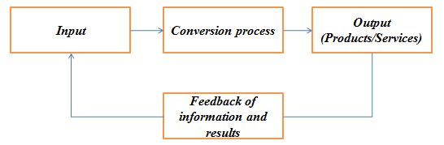
System approach applied to Organization
The systems approach considers organization as a system composed of sub systems that are inter-related.
Systems have boundaries, but they also interact with external environment. That is, they are open systems. This approach recognizes the importance of studying inter-relatedness of planning, organizing, and controlling in an organization as well as the many subsystems.

Slide 44
Necessity of Organization
Complexity of Industry
Growing Competition
Optimum utilization of resources
Fixation of authority and responsibility
Reduced labour problems
Co-ordination and directing efforts
Facilitates administration
Stimulates creativity.

Slide 45
Essential Elements of good Organization
It must be helpful in the achievement of objectives.
There must be harmonious grouping of activities.
The activities of the organization must be co-ordinated properly.
An organization must be complete in all respects.
Proper division of work and labour
An organization should have an effective communication system.
The Span of control should be reasonable.
Provision of expansion
Clear and well defined policies and procedures
Employees satisfaction is essential
Proper division of authority and responsibility.

Slide 46
Characteristics of Organization
Organization is made up of a group of people
The group works under an executive head
Organization is a tool of management
It leads to division of work and responsibilities
It defines and fixes the duties and responsibilities of employees
It establishes a relationship between authority and responsibility and controls the effort of the group
Organization is a step towards achievement of established goals

Slide 47
Process of Organization (Steps in organizing process)
Determination of objectives, strategies, plans and policies.
Determination of activities
Separation and grouping of activities
Delegation of authority
Delegation of responsibility
To establish inter-relationships
Providing physical facilities and proper environment
Preparation of Organisation chart

Slide 48
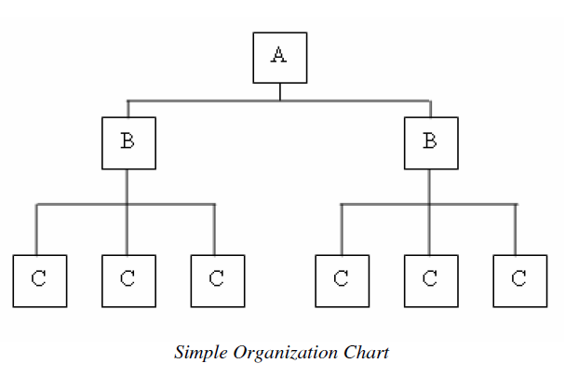
Organization Chart

Slide 49
Principles of Organization
Consideration of unity of objectives: the objectives must be clearly defined for the entire enterprise, for each dept. and even for each position in the organisation structure.
Principle of specialization: Work should be distributed among the persons very carefully on the basis of their skill, experience and ability to do that work.
Principle of authority: Line of authority should be clearly established in the structure of organisation in order to avoid overlapping actions, omission of acts etc.
Principle of Co-ordination: Different depts. should have to co-ordinate with each other to achieve common goals.
Principle of unity of command: Each subordinate should have only one superior and dual subordination should be avoided.
Principle of Span of control: The no. of persons who are directly responsible to the executive is called span of control. In an average firm SOC range is from 6 to 20.

Slide 50
Principles of Organization
Principle of exception: Only exceptionally complex matters should be referred to the executives for their decision and matters of routine nature should be decided by the sub-ordinate themselves.
Principle of flexibility: The organisational structure should be flexible enough to permit slight alterations and expansions whenever needed, due to changed circumstances.
Principle of simplicity: The organisational structure should be simple with minimum no. of levels
Principle of Responsibility: the superior should be held responsible for the acts of his subordinates to whom he has delegated authority.
Principle of balance: There should be balance between;
- the activities
- authority and responsibility
- standardization of procedures and flexibility
- centralization and decentralization

Slide 51
Principles of Organization
Principle of continuity: The Organization structure should be in such a way that it enables to continue its useful existence for a longer period.
Scalar principle: The authority originating from the top should flow below without any interruption.
Principle of parity between authority and responsibility: Authority means ability of the superior to command and responsibility means the obligation of the subordinates to a superior to perform the assigned task. Both should go hand in hand.
Principle of efficiency: Enabling the enterprise to attain objectives with minimum cost and effort.
Principle of Communication: A good communication system is essential for smooth flow of information.

Slide 52
Types of Organization
Formal Organization
FO are those which have a system of well defined positions, authority, responsibility, rules, policies, principles etc.
They are co-ordinated towards a common objectives.
Informal Organization
Arises from the personal and social relations of the people which may or may not be work related.
Arising spontaneously as people associate with one another.

Slide 53
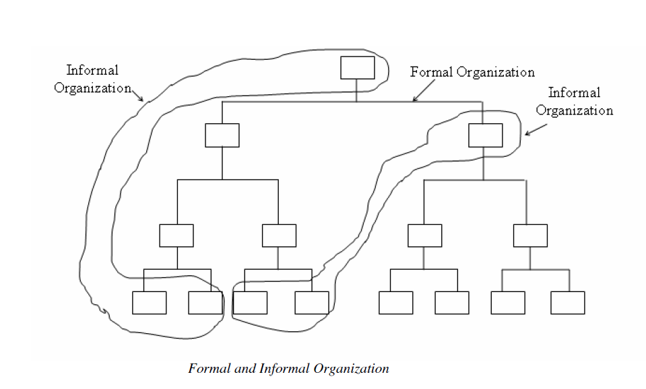
Types of Organization

Slide 54
Organization Structure
OS means the systematic arrangement of people working for the organization and their relationship between positions.
It defines the functions to be performed, objectives to be established, the availability of resources, working relationship of the individual participants etc.
Factors
Size of Org.
Nature of the product being manufactured.
Complexity of problem being faced.

Slide 55
Types of Organization Structure
A few commonly known forms of organization structures or types of organization are:
1) Line organization
2) Line and staff organization
3) Functional Organization
4) Project Organization, and
5) Matrix Organization

Slide 56
Line Organization
Based on similarities of activities, different departments are created.
Each department is placed under one department head & he/she has the full authority all over them.
Authority flows from top to bottom in a vertical line.
Unity of command is maintained.
Superior will be responsible for the performance of sub-ordinate to his commanding officer.
Line Organization is also called military or scalar organization.
Line organization is suitable for small concerns and for automatic and continuous process industries such as paper, sugar, cement, textile, etc.

Slide 57
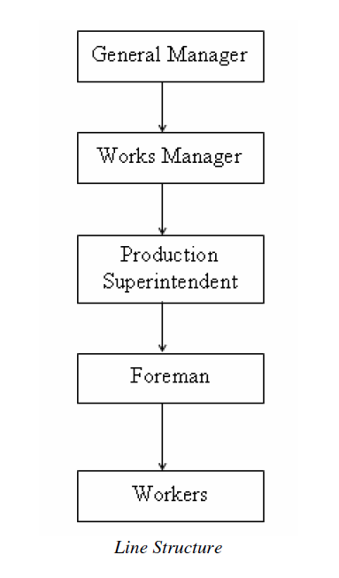
Line Organization

Slide 58
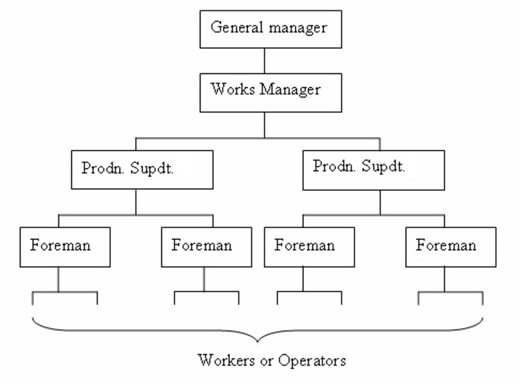
Line Organization

Slide 59
Advantages of Line structure
Simplicity and clarity
Clear cut authority and responsibility
Strong discipline
Capable of developing all round executives at higher levels of authority

Slide 60
Disadvantages of Line structure
Neglects specialists
Lack of specialization may lead to wastage of materials as well as man and machine hours
Overloads a few important executives
Encourages dictatorial way of working
Limited to very small concerns

Slide 61
Line and staff organization
In a big organization manager will have to do a variety of functions and he may not be expertise in all areas.
Special executives will be employed to assist line executives and they were known as staff, whom to perform specialized function.
Supervisory authority will be given for line executives and the staff executives gives advices and expert opinion, have no direct authority.

Slide 62
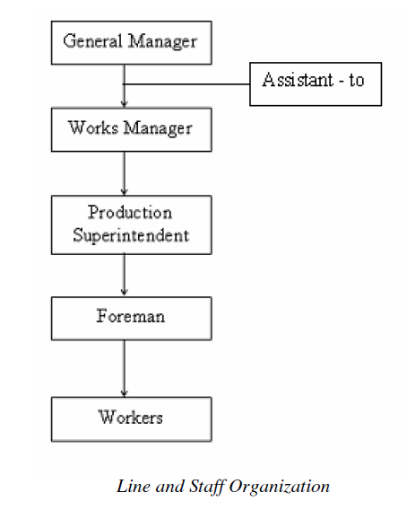
Line and staff organization

Slide 63
Advantages of Line and staff organization
Specialization benefits of staff can be profitably utilized to have standard operations.
Line executives are relieved of some of their workloads and are thus able to concentrate on other important matters.
Less wastage of material and labour
Improved product quality
Relatively flexible

Slide 64
Disadvantages of Line and staff organization
Staff – line conflict
Paper work may be increased very much
Staff men may dominate over the lower the lower-level line managers
Increased product cost because of high salaries of staff executives
Too much staff activity may complicate a line executive’s job of leadership and control

Slide 65
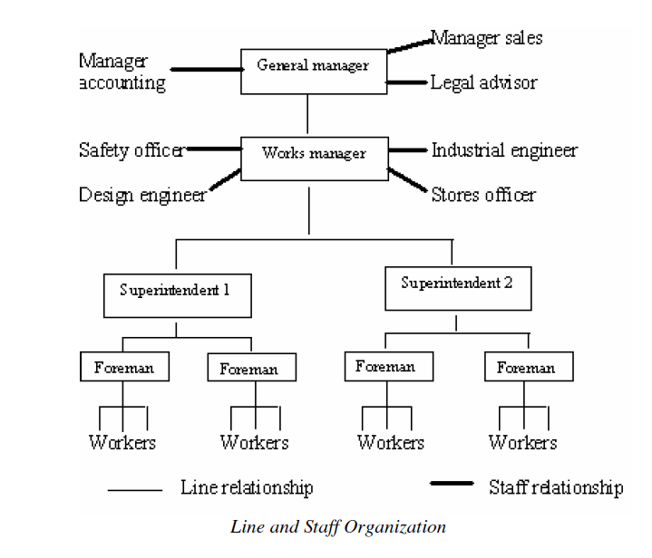
Line and staff organization

Slide 66
Functional organization
Modified form of line organization
Authority rests with functional heads
Staffs are grouped and located by specialty into functional departments: each headed by a functional manager. Each member of staff has one clear boss.
Functional manager are specialists in their respective areas and is based on high degree of specialization.
This specialization leads to greater efficiency and refinement of particular expertise.
The functional structure helps to focus on those departments that are critical for the success of the enterprise.

Slide 67
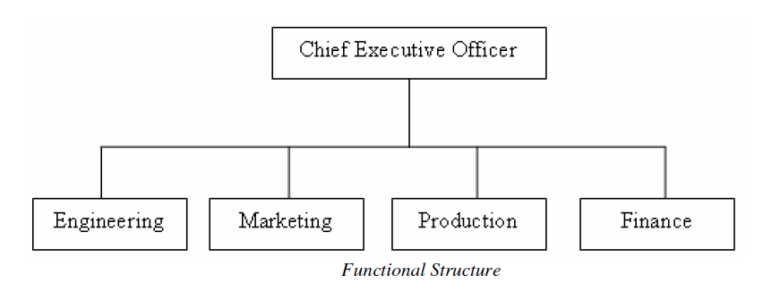
Functional organization

Slide 68
Advantages of Functional organization
Efficient use of resources
Simplifies training
Promotes professional development
Centralized control of strategic decisions
Improved quality of work

Slide 69
Disadvantages of Functional organization
Limits development of general managers or all-round executives
Restricted view of company objectives
Difficulty in multifunctional decision making
Promotes narrow specialization
Makes industrial relationships more complex

Slide 70
Project Organization
Firms dealing with multiple products or different projects usually adopt project organization.
It consist of an autonomous project team, existing independently of the rest of organization.
The emphasis in project organization is on creation of teams for the accomplishment of specific objectives.
The project team is assembled for a specific project under the action of project manager.
The team is thus temporary and will be dispersed when the project is completed.

Slide 71
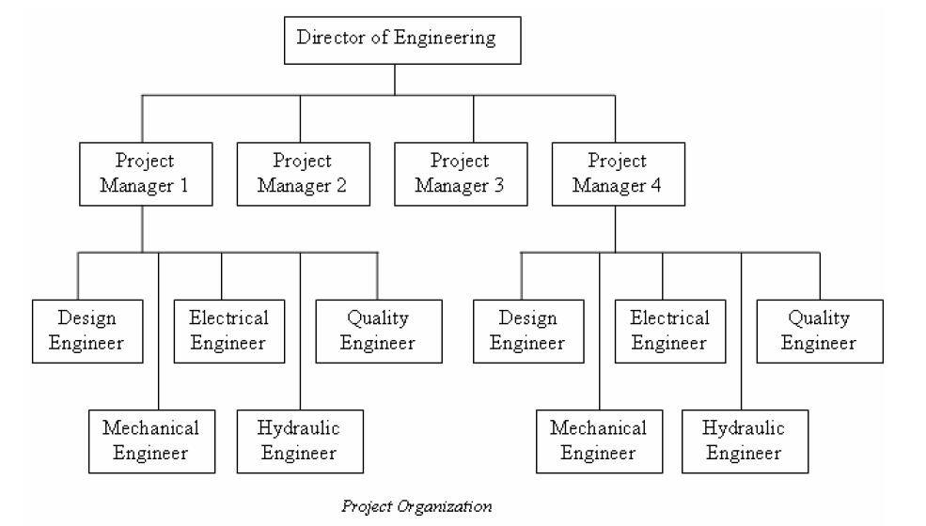
Project Organization

Slide 72
Advantages of Project Organization
Flexibility
Responsive to changing environment
Encourages team work

Slide 73
Disadvantages of Project Organization
Projects can be of short duration leading to frequent change in organization structure
Professionals prefer to be allied with their professional group rather than being allied with a project
Trained professionals need not tolerate the insecurity of frequent organization change

Slide 74
Matrix Organization
They are those that comes between fully functional and fully project organizational structure.
Staffs are grouped and located by speciality into functional units headed by a functional manager.
The project manager works with the functional manager for timely completion of project.
The matrix organization is an organization structure that establishes two chains of command, one vertical and one horizontal, at the same time.
It is intended to combine the advantages of functional structure and project structure.

Slide 75
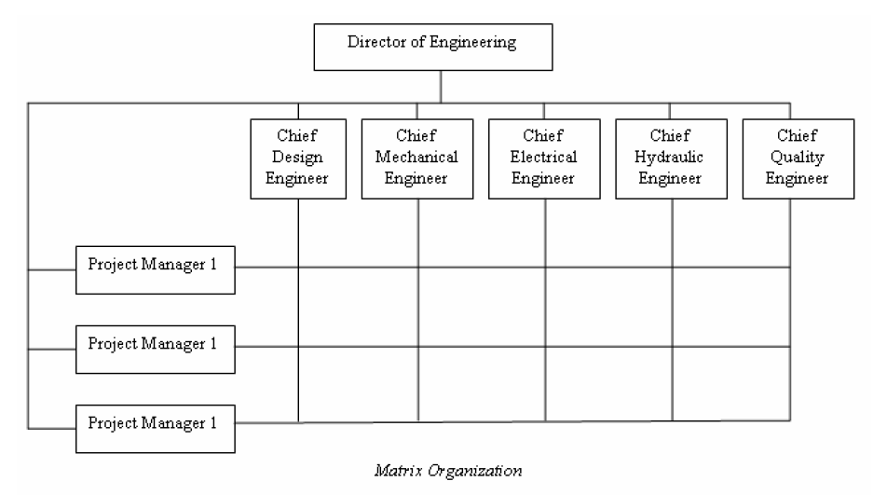
Matrix Organization

Slide 76
Advantages of Matrix Organization
Decentralized decision making
Efficient use of functional managers
Capable of adapting to fast environmental changes
Flexibility

Slide 77
Disadvantages of Matrix Organization
Violates the principle of unity of command
High administrative costs
Requires tremendous horizontal and vertical co-ordination
Chances of interpersonal conflicts

Slide 78
Topics (Part 4) FORMS OF BUSINESS ORGANIZATION
Concept of Ownership organization
Types of ownership
Individual ownership
Partnership
Joint stock company
Private and public limited company,
Co-operative organizations
State ownership
Public corporation

Slide 79
Ownership Organisation
A firm is an Ownership organisation which combine the factors of production in a plant for the purpose of producing goods or services and selling them at profit.
Business
Business may be defined as an activity in which different persons exchange something of value, whether goods or service, for mutual gain or profit.
Factors
Size and nature of organisation
Technical difficulties
Market competition and scope of articles in markets
Capital required
Limitations and restriction put forth by govt.

Slide 80
Types of Ownership
Private Sector
1. Individual Ownership
2. Partnership
3. Joint Stock Company
4. Co-operative organization
Public Sector
1. Departmental Organisations
2. Public corporations
3. Government Companies
Joint Sector

Slide 81
PRIVATE SECTOR
Private sector organizations, as the name indicates, are exclusively owned by private individuals.
The efficiency of the private sector organizations is usually very high compared to organizations from any other sector.
The important forms of the private sector organizations are:
Individual/Single ownership
Partnership
Joint stock companies
Cooperative organization

Slide 82
1. Individual/single Ownership
Simplest and oldest form of Organisation.
Individual entrepreneur supplies the entire capital, also known as sole proprietorship.
Entire Authority & responsibility belongs to him and also the profit and loss.
An individual introduces his own capital, uses his own skill and intelligence in the management of its affairs and is solely responsible for the results of its operation.
In Short it’s a “one man business”, if need he can employ a person to assist him.
His liabilities will be unlimited.
Applications.
Small scale industries
Risk covered is not too heavy
Management by one man is possible

Slide 83
Advantages of Individual/single Ownership
Ease of formation and dissolution.
Direct relationship between effort and reward serves as a powerful incentive to the proprietor to manage the concern efficiently
Ease of coordination
Promptness in decision-making
Flexibility in management
Secrecy of the affairs of business can be maintained
Freedom from government regulations

Slide 84
Disadvantages of Individual/single Ownership
The amount of capital that can be invested is limited, therefore, rendering it unsuitable for modern business
All the qualities required for success in business are rarely found in a single person
The liability of the sole proprietor will be unlimited
Uncertainty of duration as the firm may cease to exist with the death of the proprietor

Slide 85
2. Partnership Organization
Owned by 2 or more persons who share the power, responsibilities and profits according to an agreement reached amongst themselves.
Person may possess exceptional business ability, experience, talent but no capital, then he can have a financing partner (vice versa).
“Partnership deed” – written agreement
Indian partnership act defines partnership as the relation between persons who have agreed to share profits of a business carried on by all or any of them acting for all.
The contribution of the partners in running the business need not be same.

Slide 86
2. Partnership Organization
The partnership is created by mutual consent and voluntary agreement.
Registration of a business under partnership is essential under shops and establishment act in order to take legal help in enforcing the terms of agreement on the partners.
Every partner has an unlimited liability in respect of the firm’s debt and limitation of the liability through mutual agreement is not possible legally under partnership.
active partners
sleeping partners
nominal partners
secret partners
minor partners

Slide 87
Advantages of Partnership Organization
Ease of formation as there are very little legal formalities
Larger financial resources as compared to single ownership
Balanced judgment as the partners possesses various sorts of talent, expertise and experience
Adequate credit availability because of unlimited liabilities of the partners
Flexibility of operation
Secrecy in business
Losses, if any, are shared by the partners

Slide 88
Disadvantages of Partnership Organization
Unlimited liabilities of each partner
All partners suffer because of the wrong steps taken by any of the partners
Uncertain life as partnership may dissolve by death or insolvency of a partner
Lack of public confidence as the affairs of the business are kept secret and the accounts is not published
Non-transferability or restricted transferability of the partners’ interest in the business

Slide 89
3. Joint Stock Company
It is a voluntary association of individuals for profit, having a capital divided into transferable shares of different values.
Persons who purchase shares are called Share Holders and managing body is known as Board of Directors, whom elected by the Share Holders.
Legal business owned by the shareholders having limited liability and managed by an elected Board of Directors.
Capital is contributed by large number of persons in the form of shares of different values.
In this form of organization liability of the shareholder is limited to the amount of shares held by him and he is free from the responsibility of the debts and claims of the company beyond the value of shares.
Types:- a) Private Ltd. Company b) Public Ltd Company

Slide 90
a) Private Ltd. Company
Owned and managed by a group of members from family, relatives or friends.
Formed by 2 or more members & maximum is limited to 50.
Transfer of share is limited to members only and general public cannot be invited to purchase shares.
A private limited company need not make the prospectus, accounts and other particulars open to public.
The government also does not interfere on the working of the company. A private limited company, while conferring the advantage of limited liability, allows a business to be privately owned and managed.

Slide 91
b) Public Ltd company
It is opened to general public
Minimum number of persons are 7 and there is no upper limit.
They are subjected to greater control and supervision of the govt.
This control is necessary to protect the interest of the shareholders and the members of the public.
The affairs of the public limited company should be made open to public by publishing in leading newspapers.
Shares are transferable without any prior approval.
The affairs of company are managed by BOD
The public limited companies can advertise to offer its share to general public through a prospectus and there is no restriction on the transfer of shares

Slide 92
Private Ltd Company Vs Public Ltd Company
Sl. No | Basis of Description | Private Ltd | Public Ltd
1 | Minimum no: of members | Two | Seven
2 | Maximum no: members | Fifty | Unlimited
3 | Invitation of public for capital | No | Yes
4 | Transferability of shares | Restricted to members | Free
5 | Secrecy | Possible | Not possible
6 | Prospectus | Not necessary | Yes, necessary
7 | Minimum no: of directors | Two | Three
8 | Exemption from legal restrictions | Yes | No
9 | Quick Decision | Possible | Not Possible
10 | Protection to members | Less | More

Slide 93
Advantages of Joint Stock Company
Availability of large capital
Limited liability
Not affected by the death or retirement
Risk of loss is divided among the shareholders
Ease of expansion
Services of specialists can be obtained
Cheaper and better production because of large-scale production with the use of modern technology, which the company can afford

Slide 94
Disadvantages of Joint Stock Company
Lack of personal interest on the part of the salaried manager can lead to inefficiency and waste.
Board of directors and managers who have intimate knowledge of the financial position of the company may purchase or sell the shares accordingly for their personal profits
Requires a great deal of legal formalities to be observed
Difficult to maintain secrecy
Few shareholders having greater number of shares may secure control over the company
Slow decision-making

Slide 95
4. Co-operative Organization
Its an Organisation where in persons voluntarily associate as human beings for the fulfillment of their common economic interests.
Set up with a primary objective of helping its members rather than making profit.
The primary motive of a cooperative society is to provide maximum service to its members and not to make profits.
This does not, however, mean that a co-operative does not work for profit at all.
Whatever is the profit, it will be partly distributed as bonus to its members.
Types
1. Producers Co-operative society
2. Consumers Co-operative society
3. Housing Co-operative society
4. Co-operative Credit society

Slide 96
Producer’s Co-operative society
They are formed to protect the interest of small producers by making available items of their need for production (like raw materials, tools etc)
For buying and selling the products, produced/cultivated by the members to eliminate middlemen and get better prices.
Eg: handlooms, coir, handicrafts etc.
2. Consumer’s Co-operative society
For the retail trade of household and consumable items.
Eg: Stores in School & Colleges.

Slide 97
3. Housing Co-operative society
Formed for the purpose of getting plots or constructing houses for needy persons by providing loans, reducing cost of construction etc.
4. Co-operative credit Society
It’s objective is to finance the poor cultivators by providing loans at low Rate of Interest (ROI) for developing land, buying agro machineries etc.
Formed by persons working in the same organisation to provide loans to the members in case of financial difficulties etc.

Slide 98
Advantages of Co-operative Organization
Democratic management
Limited liability
The life of a cooperative society is not affected by the death or insolvency of a member
Ease of coordination because of the cooperation among the members of the society
Monetary help can be secured from government
Helps development of moral character

Slide 99
Disadvantages of Co-operative Organization
Limitation of capital
Excessive government regulation
Lack of secrecy
Insufficient motivation
Inefficiency of management as the members generally lacks technical knowledge and may not be competent enough

Slide 100
PUBLIC SECTOR
Owned and managed by Central or State government.
Controlled and operated by the govt. or in association with private enterprises.
Public sector companies are established by the government to produce and supply goods and services required by the society.
Public sector prevents the economic unbalance in the nation.
It also serves as a means to obstruct the monopolistic tendencies.
Capital is invested by the govt. or govt. controlled financial institutions like LIC, UTI, Public sector banks etc.
Public Sector Undertaking (PSU) is a term used to refer companies in which the govt: owned a majority (51% or more) of the company equity.

Slide 101
PUBLIC SECTOR
The important forms of public sector organizations are:
Departmental organizations
Public corporations
Government companies

Slide 102
1. Departmental Organizations
It’s the business organisation which are owned, managed and run by the govt: or local bodies like municipality, district board etc.
Generally done in the case of water supply, electricity, gas, bus, railways, navigation etc.
A top executive appointed by the ministry concerned will manage the organization.
In certain organizations cooperation from several ministries may be required and in such cases a board or committee of representatives from the ministries concerned will manage the organization.
Social benefit is of primary importance while profit motive is given as secondary consideration.
Eg: Railways, Posts and Telegraphs etc.

Slide 103
2. Public Corporations
Owned by the govt-either Central, State or local bodies.
It is managed by the Board of Directors nominated by the government.
It combines the public interest of the govt. body & autonomous management of the public sector.
Though the total capital is provided by the government, they have separate entity and enjoy independence in matters related to appointment, promotions etc.
Public service rather than profit maximization becomes the main aim of such corporations.
Eg: FCI, ONGC, Financial corporation, Industrial development corporation etc.

Slide 104
3. Government Companies
A govt. company is any company in which not less than 51% of the share capital is held by the Central or State govt: or partly by both.
Managed by elected Board of Directors.
Eg: FACT, HAL, HLL, HMT etc.

Slide 105
Advantages of Public Sector
Helps for the betterment of the community and for the welfare of the people
Facilities like power, transport, credit, and insurance, etc are easily made available to public sector units
Because of the government control economical and social objectives can easily be achieved
Provides better working conditions to the employees and cheaper and better products and services to the customers
Encourages industrial growth of under-developed regions in the country
Provides employment opportunities to all sections of the people
Prevents monopolistic tendencies and paves the way for equitable distribution of wealth among different sections of the community

Slide 106
Disadvantages of Public Sector
Because of bureaucratic control generally timely decisions are not taken
Lack of initiative among workers because promotions are seniority based rather than merit based
Too much of interference by the political leaders and government in the internal affairs of public sector units
Misuse of excessive freedom (compared to private concerns) cannot be ruled out
Inadequate accountability
Government officials prefer to work according to certain rules and regulations and therefore lesser flexibility
Incompetent persons may occupy high levels

Slide 107
JOINT SECTOR
The concept of joint-sector implies the participation of both the government and the private sector in the share capital and general management of the business.
It combines the best aspects of both private sector and public sector organizations and aims at achieving the task of social justice through efficient use of resources.
Joint sector firms can be a pure Indian firm or an Indian firm with foreign collaboration

Slide 108
Advantages of Joint Sector
Helps to foster the industrial development with social justice
Checks business malpractices
Antidote to monopoly and concentration of economic power
Combines the best aspects of both private sector and public sector organizations.
Makes nationalization unnecessary

Slide 109
Disadvantages of Joint Sector
Lack of confidence between two sectors
Managerial autonomy making the owners passive in business
Inadequate accountability

